Slide 1

Group id :- 9
Topic :- Citizen Care
Group leader :- Shah Jinansh | 202312065
Group Member :- Akabari Sanket | 202312130
Disha Panjabi | 202312018
Kapadia Krishna | 202312099

Slide 2

Task Assignment
Shah Jinansh
Frontend & Backend:
Visitor :- Registration Page,Search Service,Homepage
User :- Sign up form,Search Service,Cancel Order,Payment page
Provider :- Sign upform, Reset Password
Admin :- Signup,Assign Task
Akabari Sanket
Frontend & Backend:
Visitor :- Feedback form
User :- Detailed information page,Update order details,Update Profile,View Past Order
Provider :- Update Profile,Show Profile
Admin :- Customer page

Slide 3
Task Assignment
Disha Panjabi
Frontend & Backend:
User :- Confirm mail page,Book Service,Rate reviewpage,Contact page
Provider :- Provider dashboard, Contact Page, Cancel Booking
Admin :- Review Page
Kapadia Krishna
Frontend & Backend :
Visitor :- About page,
User :- Track Status,Forgot password
Provider :- Update Booking, Confirm mail Booking
Admin :- Service Page

Slide 4

Objectives
Our system is to provide a service those senior citizen people who can’t able to do work by own-self.
Our website is to enable users to find and hire the right professional for all their needs, and the professional will show up at the pre-appointed time.
Main benefit to save the time and money of the users as well-equipped with the modern way of searching for online service providers and allocating jobs to verified professionals.
For all these services client or user can also make the payment in Online mode.
Our main aim is to provide best services through the professional at home in a way that has never been experienced before.

Slide 5

Milestones
Encryption for Password Protection
Efficient Service Confirmation, Cancellation, and Update via Email using Node Mailer
Payment Processing with Stripe Integration

Slide 6
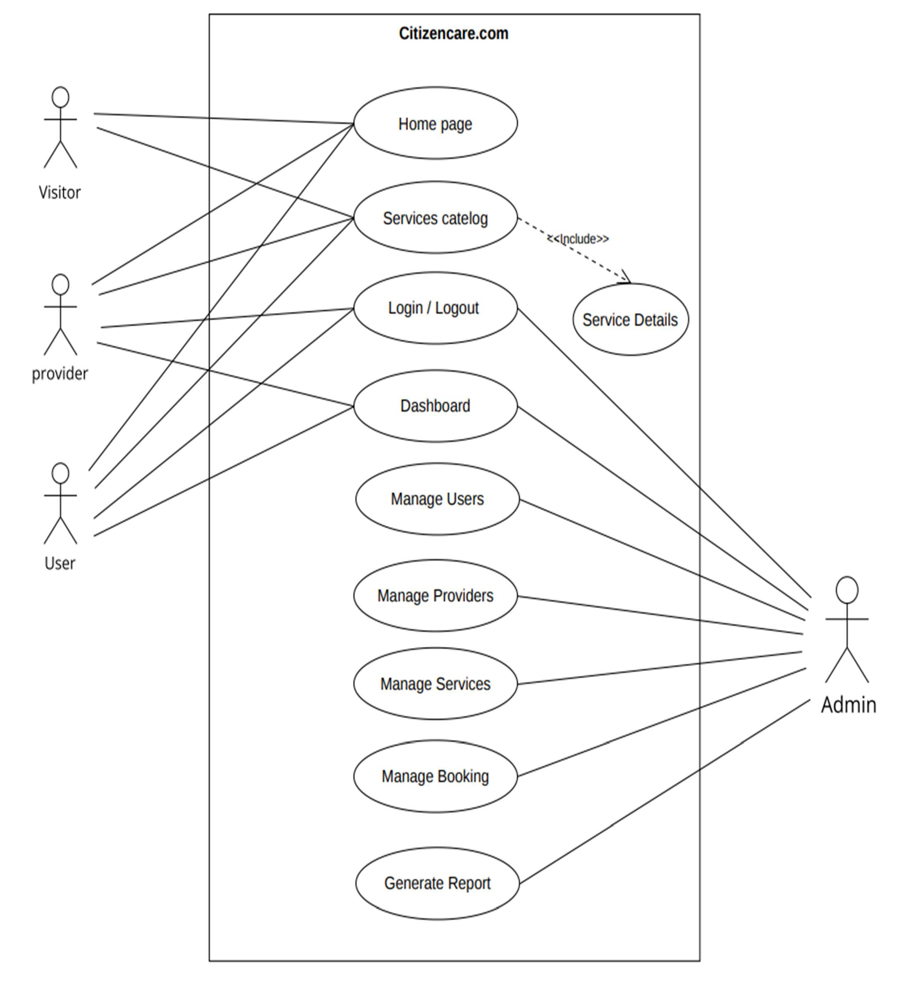
Use Case Diagram

Slide 7
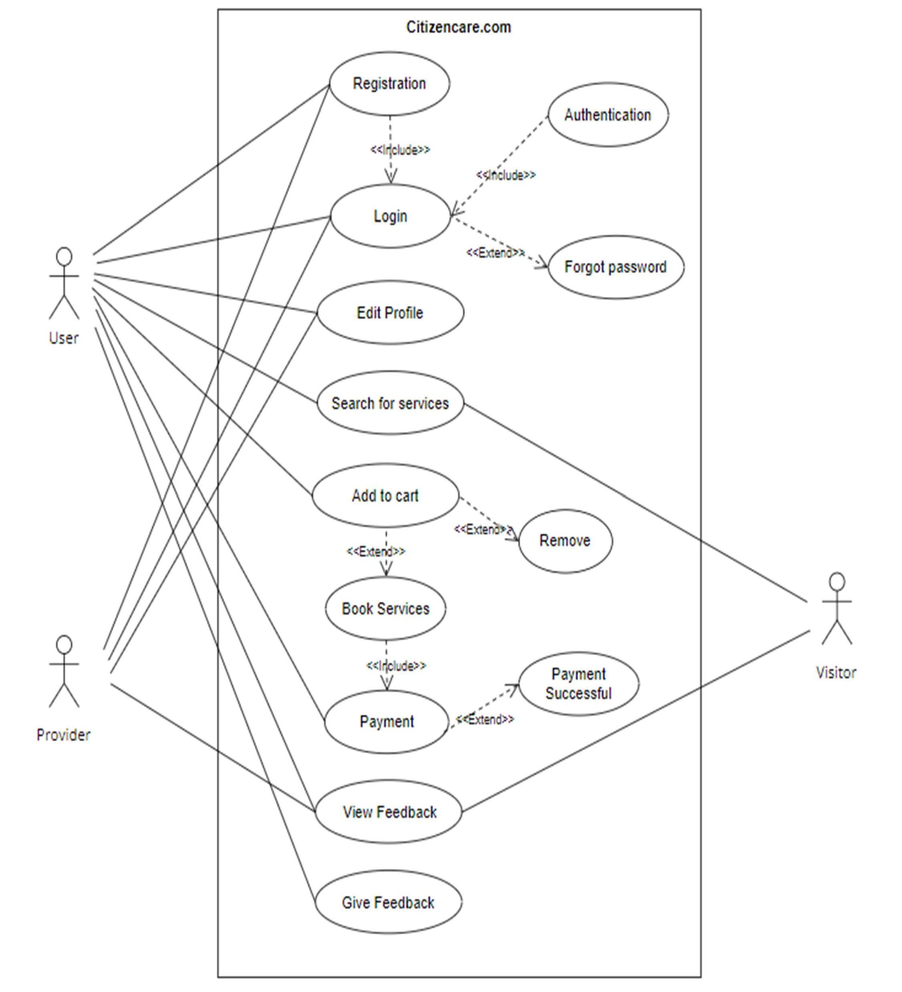
Use Case Diagram

Slide 8
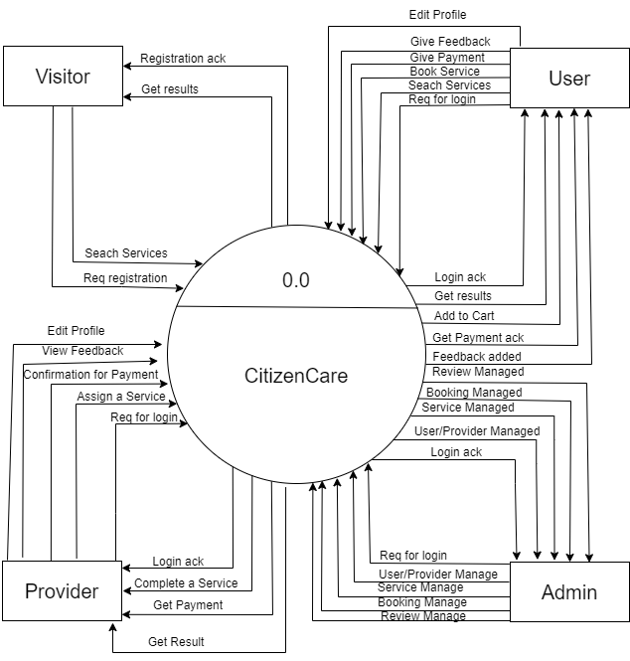
Context Level Diagram

Slide 9
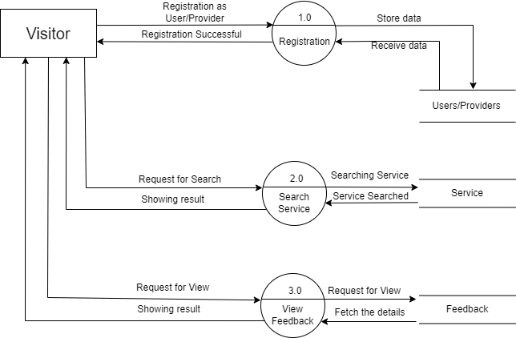
1st Level Visitor DFD

Slide 10
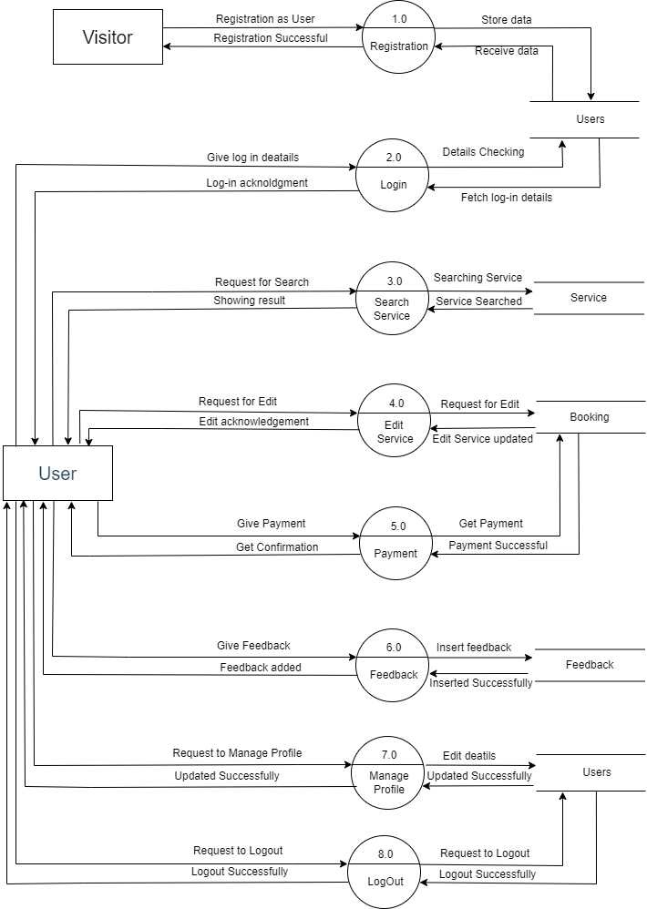
1st Level UserDFD

Slide 11
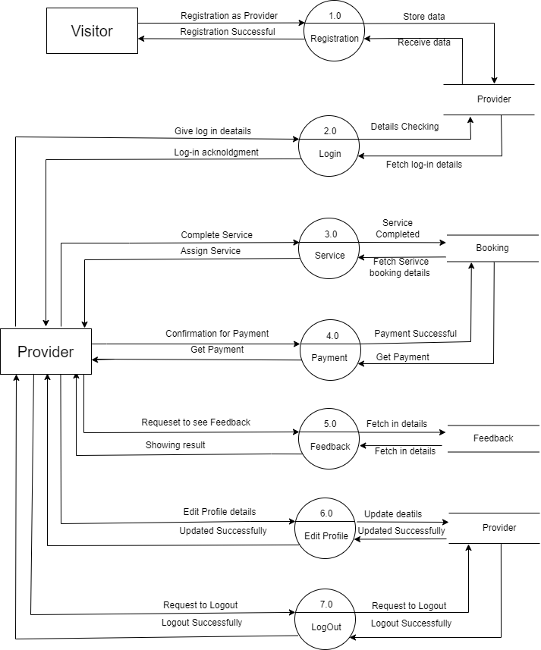
1st Level Provider DFD

Slide 12
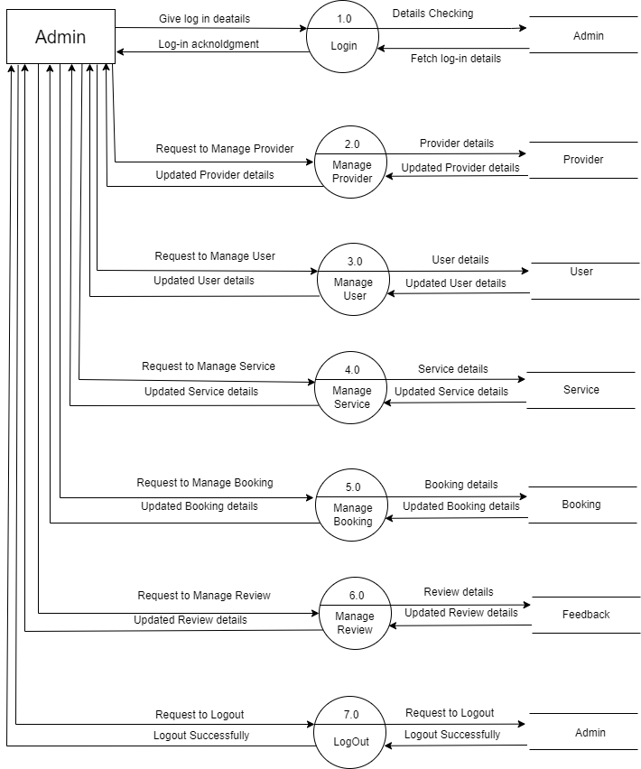
1st Level Admin DFD

Slide 13
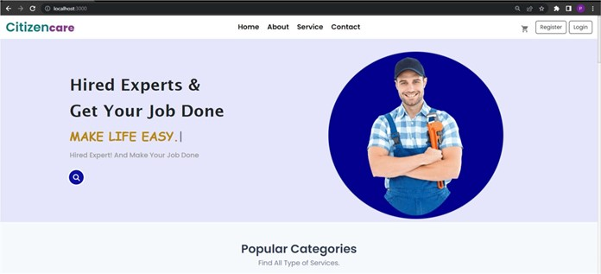
User Interface
Home Page

Slide 14
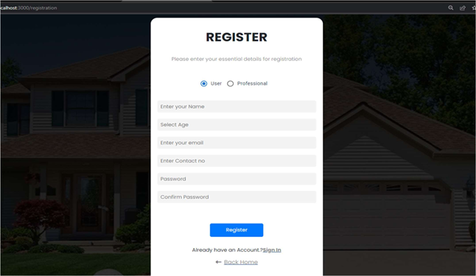
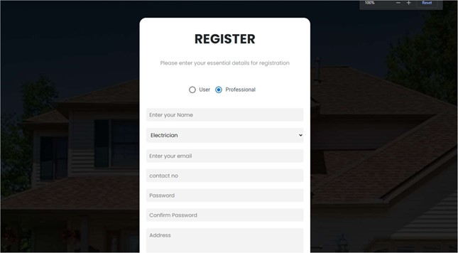
User Interface
Registration Page

Slide 15
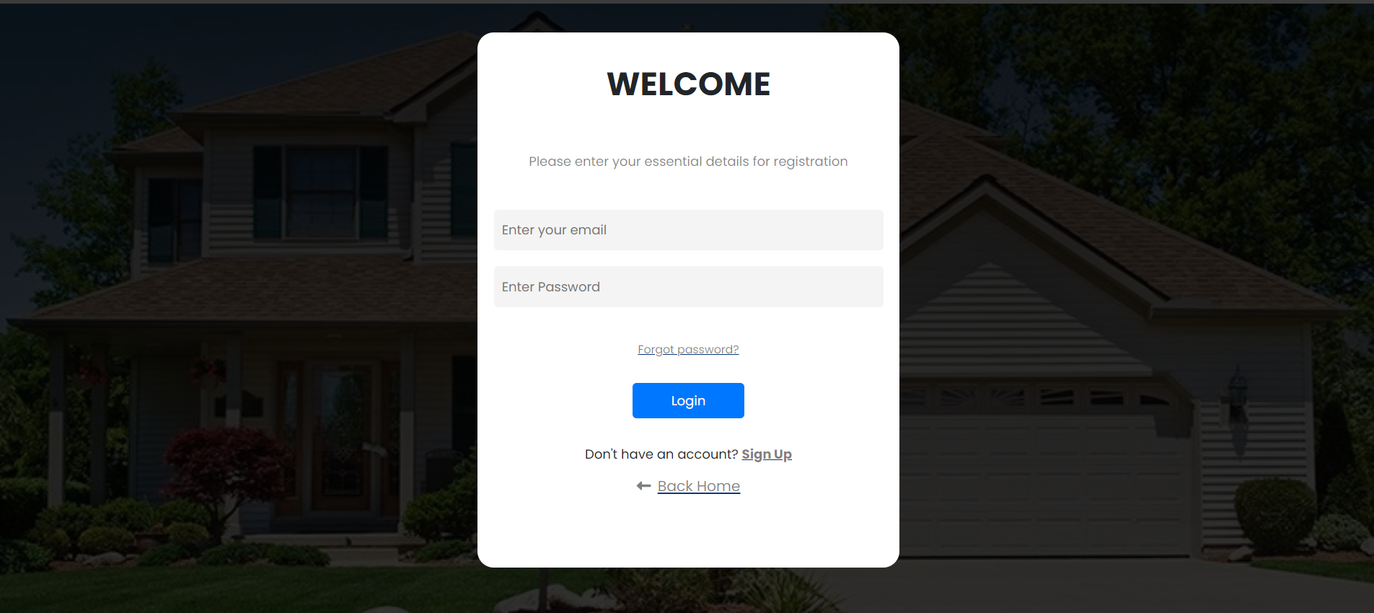
User Interface
Login Page

Slide 16
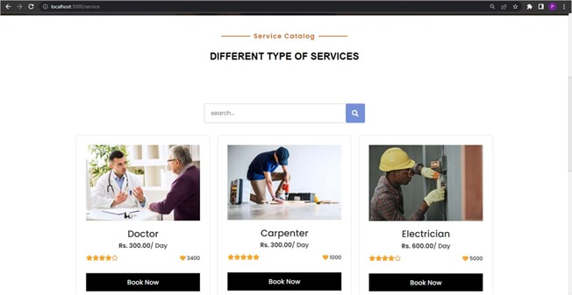
User Interface
Search Service Page

Slide 17
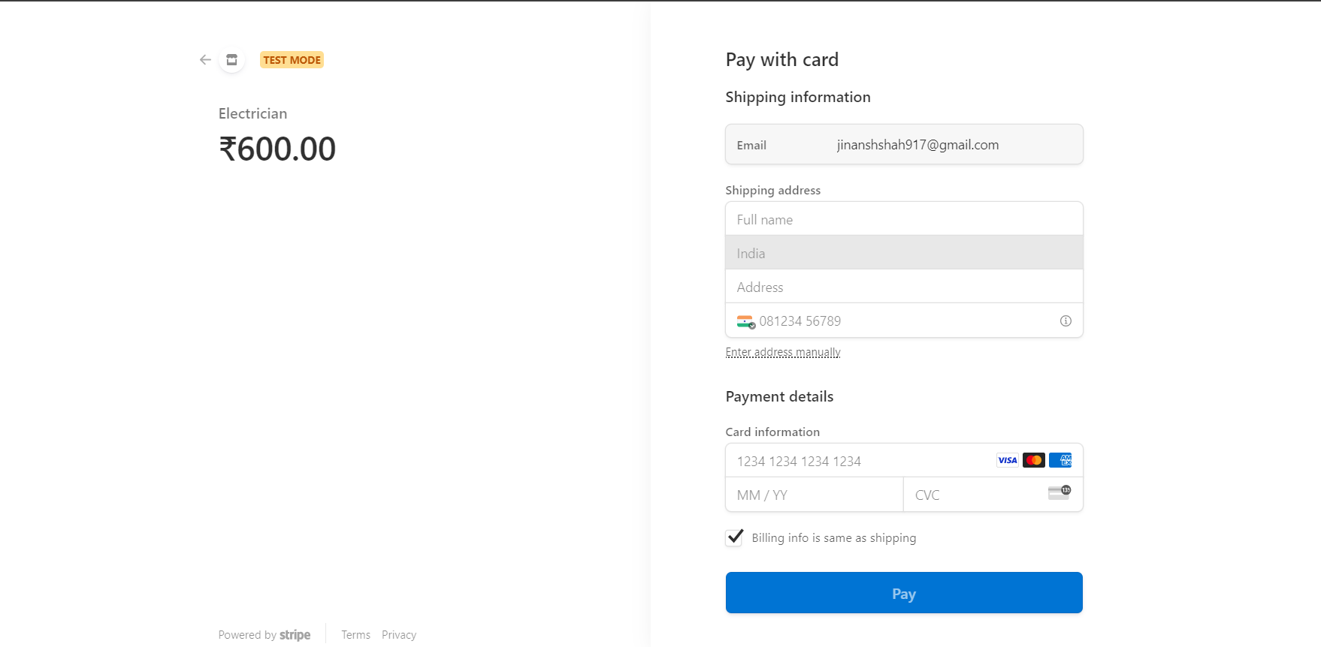
User Interface
Payment Page

Slide 18
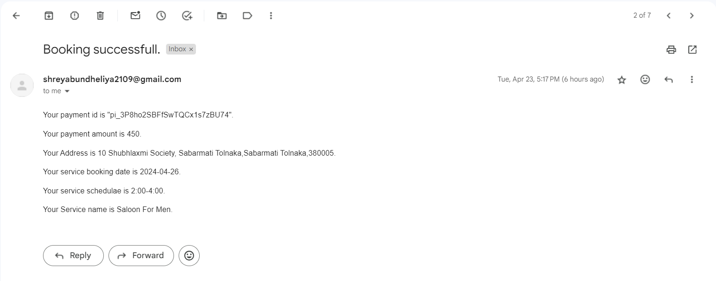
User Interface
Confirmation mail

Slide 19
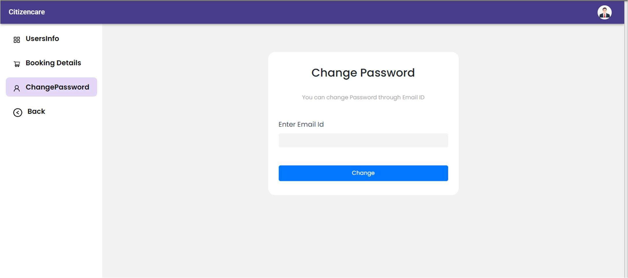
User Interface
Password forgot/ Change Password

Slide 20
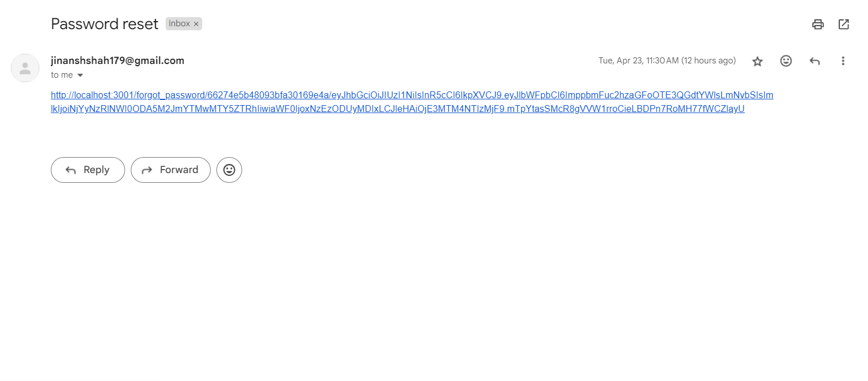
User Interface
Password Rest link

Slide 21
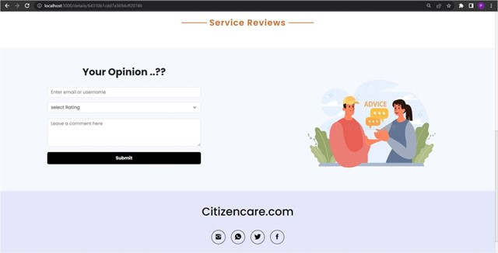
User Interface
Review Page

Slide 22
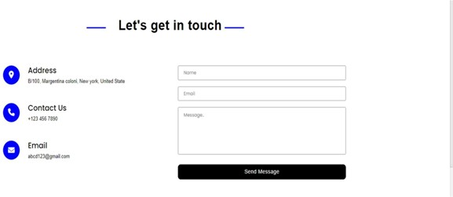
User Interface
Contact Page

Slide 23
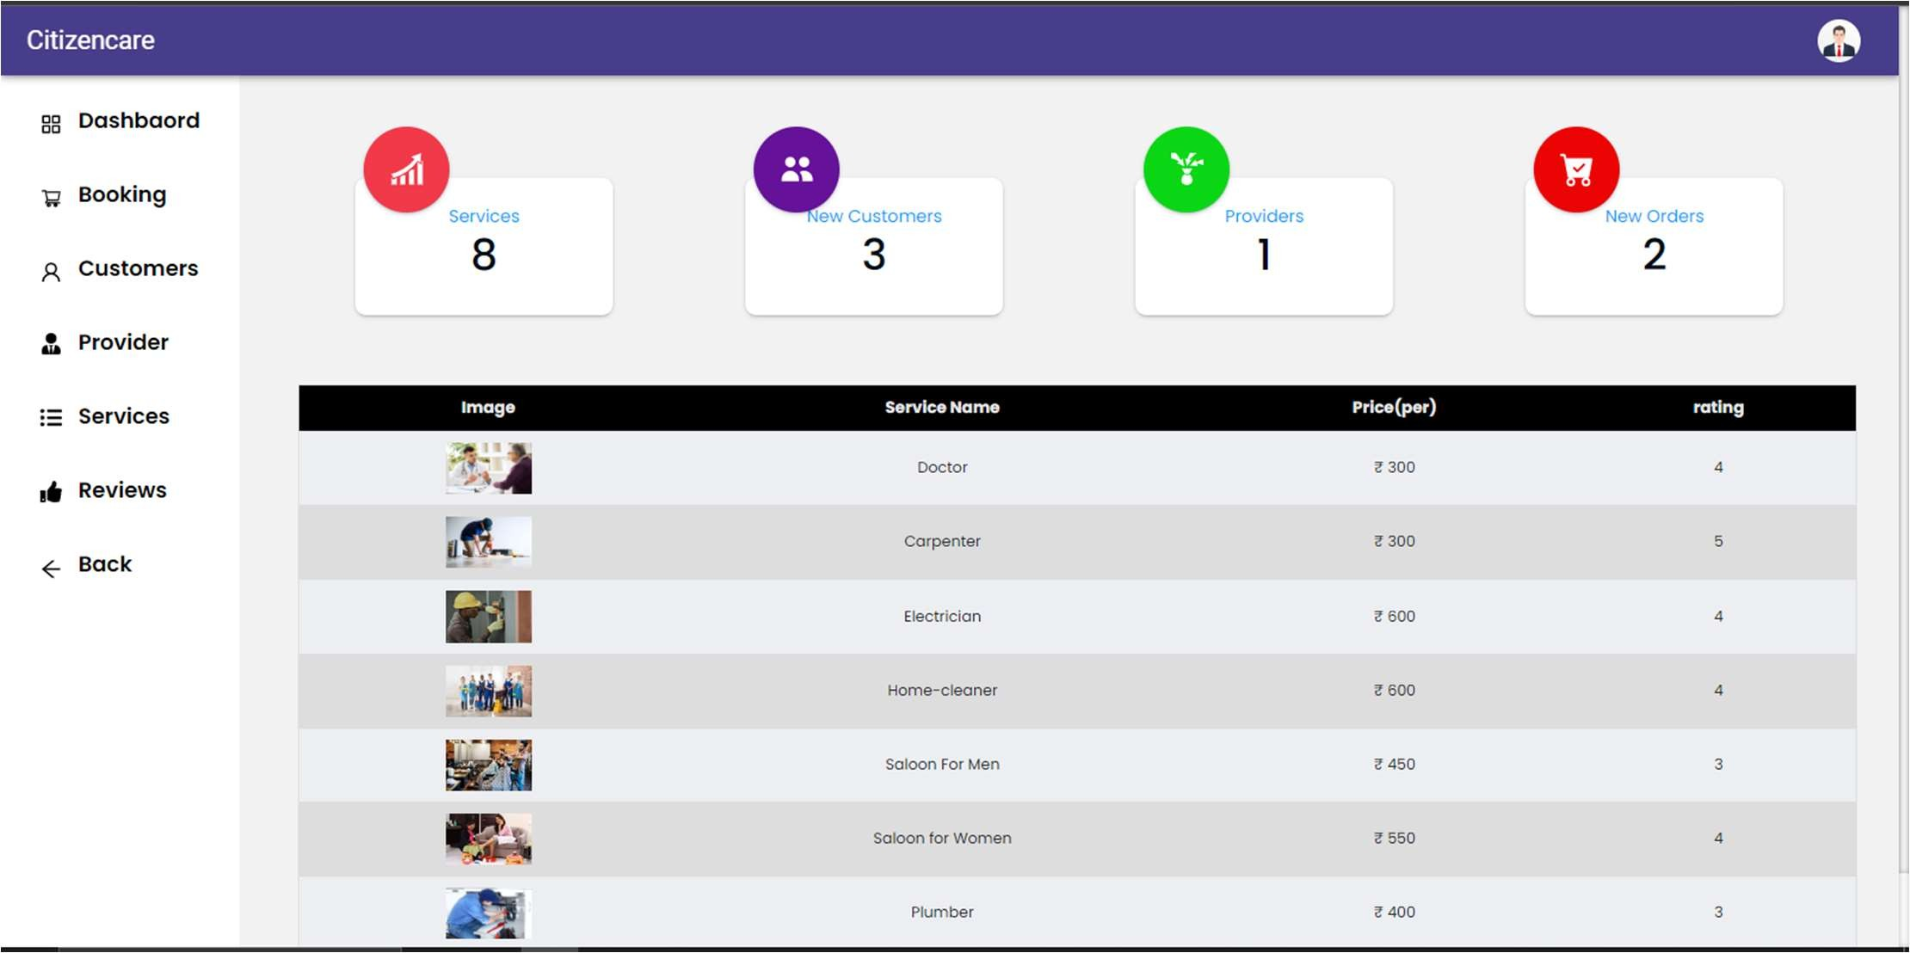
User Interface
Admin Dashboard

Slide 24
Lessons learnt by doing the software project
Database Design
Taiga – A project Management Tool
Team Collaborations
Responsibilities Division
Get to know about how Requirement Analysis is done and how requirements get frequently change.

Slide 25
Achievements
Technology Innovation
Personal Growth
Improved Collaboration and Communication with Team
Confidence Boost
One more Project added to Portfolio

Slide 26
Mistakes
Communication Gaps
Working on the taiga for the first time prevented us from managing it properly.
Payment Processing with Stripe Integration.
Not able to manage Git hub properly.
Node mailer integration takes lot of time.

Slide 27
Thank you

